Slide 1
Measure Energy consumption development part-2
To develop a project for measuring energy consumption, you can follow these steps:
1. **Data Collection**:
- Gather data related to energy consumption. This data might include information from smart meters, IoT devices, or utility bills.
2. **Data Preprocessing**:
Clean the data, handle missing values, and format it for analysis.
Transform timestamps into usable time series data.
3. **Feature Engineering**:
- Create relevant features based on your specific project requirements. This could include aggregating data by time intervals, identifying patterns, or extracting relevant statistics.
4. **Model Selection**:
- Depending on your project goals, select an appropriate model for energy consumption forecasting or analysis. Time series forecasting models like ARIMA or machine learning models like regression or neural networks may be suitable.
5. **Model Training**:
Split your data into training and validation sets for model training.
Train the selected model on the training data.
6. **Evaluation**:
- Evaluate the model's performance using appropriate metrics. For energy consumption, metrics like Mean Absolute Error (MAE) or Root Mean Square Error (RMSE) may be relevant.
7. **Hyperparameter Tuning**:
- Fine-tune the model by adjusting hyperparameters to improve forecasting accuracy.
8. **Regularization and Optimization**:
- Apply techniques to prevent overfitting and optimize the model for energy consumption predictions.
9. **Testing**:
- Assess the model's performance on a separate test dataset to simulate real-world usage.
10. **Visualization**:
- Visualize the energy consumption data and model predictions. This can help in understanding trends and patterns.
11. **Deployment**:

Slide 2
- Integrate the trained model into your energy management system or application to make real-time predictions or analysis.
12. **Monitoring and Maintenance**:
- Continuously monitor the model's performance and update it as needed with new data.
13. **Feedback Loop**:
- Collect feedback from users or energy management systems to improve the model over time.
It's important to tailor your project to the specific requirements of your use case and the available data. If you have more specific questions or need guidance on a particular step, feel free to ask, and I can provide more detailed information.
Program :
# Input: Sample daily energy consumption data energy_data = [
{'date': '2023-10-01', 'consumption_kWh': 100}, {'date': '2023-10-02', 'consumption_kWh': 120},
{'date': '2023-10-03', 'consumption_kWh': 90}, # Add more data points here
]
# Output: Calculate average daily energy consumption def calculate_average_consumption(data):
total_consumption = 0 for entry in data:
total_consumption += entry['consumption_kWh'] num_entries = len(data) average_consumption = total_consumption / num_entries return average_consumption
# Main program
if name == " main ":
average_daily_consumption = calculate_average_consumption(energy_data) print("Average Daily Energy Consumption: {:.2f}
kWh".format(average_daily_consumption))

Slide 3
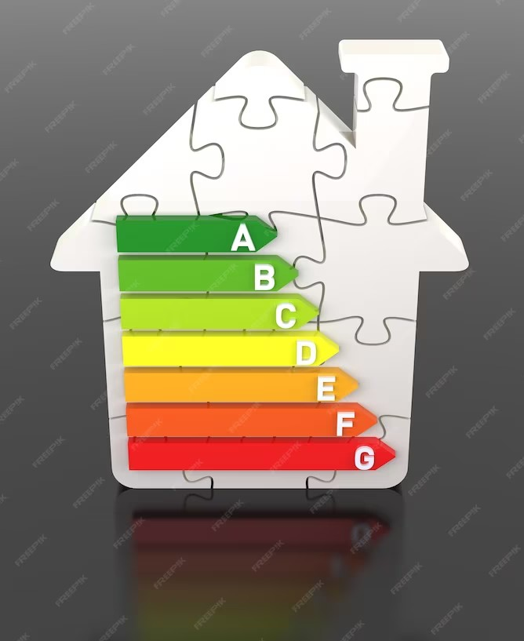
Introduction
Welcome to the presentation on Enhancing Energy Efﬁciency: A Comprehensive Approach to Measuring Energy Consumption. This presentation will explore the importance of measuring energy consumption and how it can help in improving energy efﬁciency. We will discuss various methods and tools used for measuring energy consumption.

Slide 4
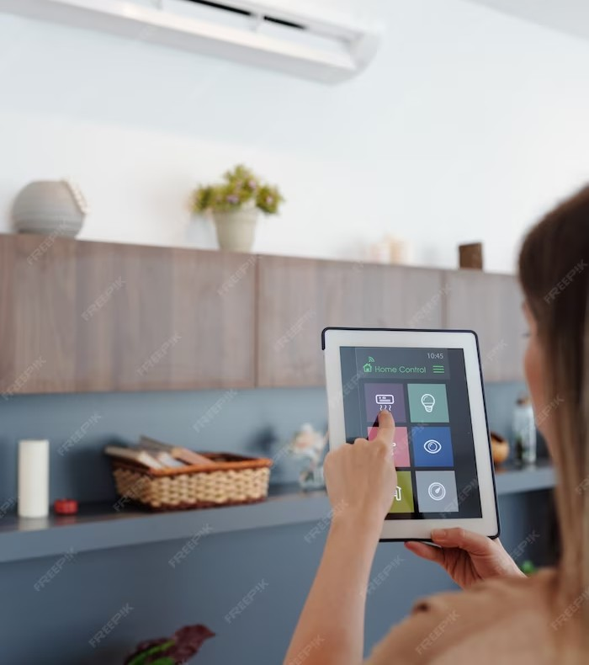
Why Measure Energy Consumption?
Measuring energy consumption is crucial for identifying areas of high energy usage and potential inefﬁciencies. It helps in identifying energy-saving opportunities and making informed decisions to reduce energy consumption. Accurate energy measurements also enable effective monitoring and evaluation of energy
efﬁciency initiatives.

Slide 5
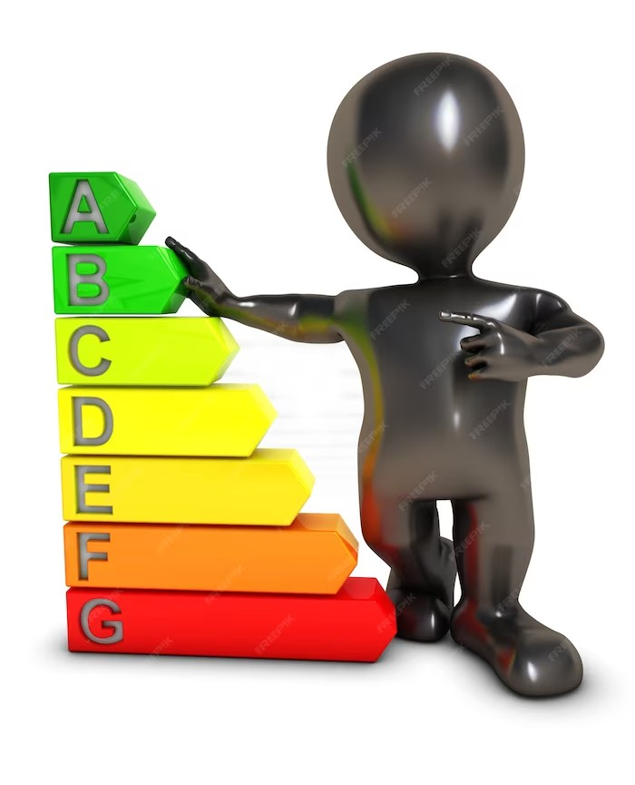
Key Metrics for Energy Consumption
There are several key metrics used to measure energy consumption, including energy intensity, energy performance indicators, and speciﬁc energy consumption. These metrics provide valuable insights into the energy efﬁciency of buildings, processes, and systems. By tracking these metrics, organizations can set targets, track progress, and benchmark against industry standards.

Slide 6
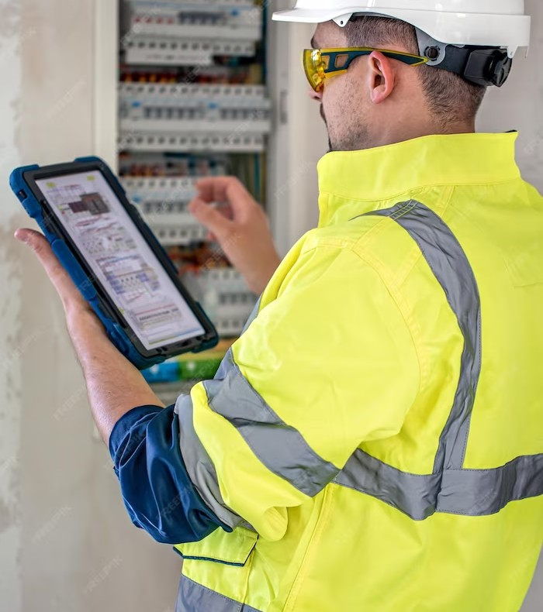
Methods for Measuring Energy Consumption
Various methods are employed to measure energy consumption, such as submetering, energy audits, and energy management systems.
Submetering allows for detailed
measurement of energy usage in speciﬁc areas or equipment. Energy audits provide a comprehensive assessment of energy consumption patterns and potential savings.
Energy management systems help in
real-time monitoring and analysis of energy data.

Slide 7
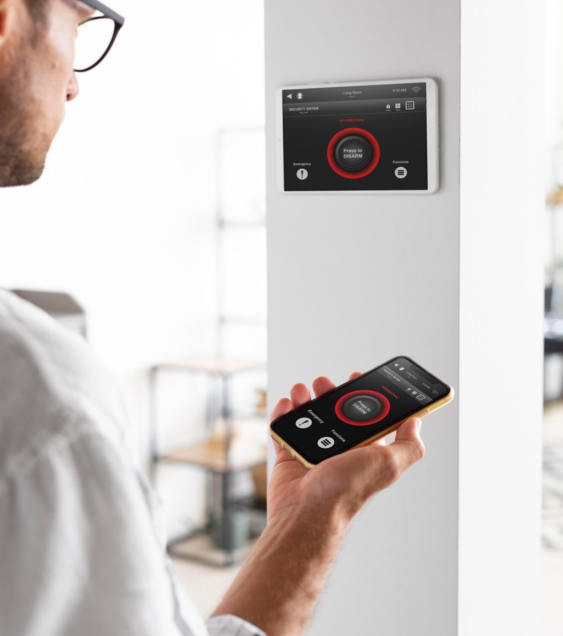
Tools for Measuring Energy Consumption
There are several tools available for measuring energy consumption, such as smart meters, data loggers, and building energy management systems. Smart meters provide accurate and real-time energy usage data. Data loggers record energy consumption over a period of time for analysis.
Building energy management systems integrate multiple energy-related data sources for comprehensive monitoring and control.

Slide 8
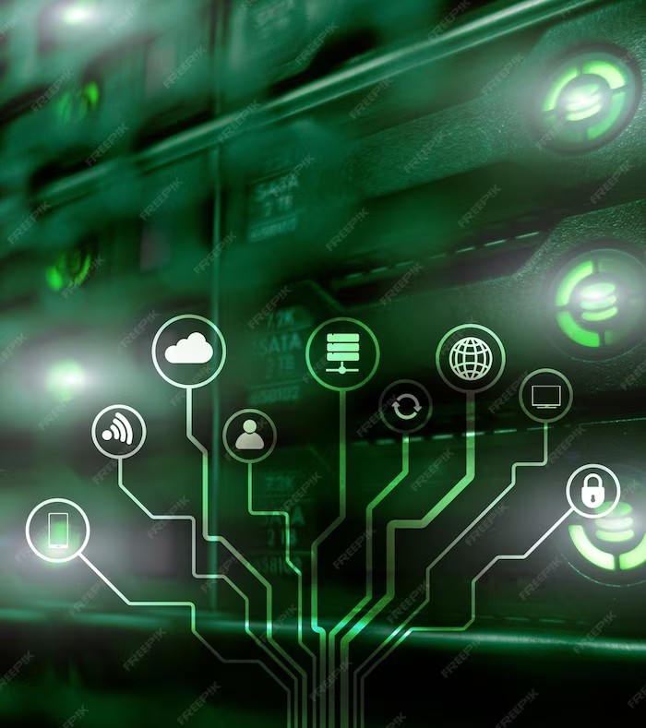
Challenges in Measuring Energy
Consumption
Measuring energy consumption can pose certain challenges, including data accuracy, data availability, and data integration. Ensuring accurate and reliable energy data can be challenging due to various factors such as measurement errors or equipment malfunctions. Availability of energy data from different sources and its integration into a centralized system
can also be complex.

Slide 9
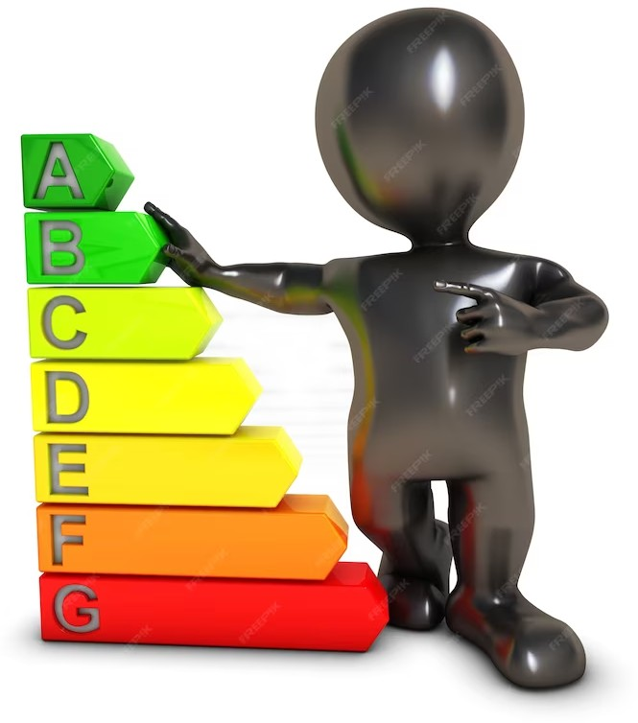
Beneﬁts of Measuring Energy Consumption
Measuring energy consumption brings several beneﬁts, including cost savings, environmental sustainability, and improved operational efﬁciency. By identifying energy-saving opportunities, organizations can reduce energy costs and improve their bottom line. Energy efﬁciency also contributes to reduced greenhouse gas emissions and environmental impact. Furthermore, measuring energy consumption helps in optimizing operational processes and
resource allocation.

Slide 10
Conclusion
In conclusion, measuring energy consumption is essential for enhancing energy efﬁciency. It provides valuable insights, helps in identifying energy-saving opportunities, and enables effective monitoring and evaluation. Despite the challenges, the beneﬁts of measuring energy consumption outweigh the drawbacks. By adopting a comprehensive approach to measuring energy consumption, organizations can achieve signiﬁcant improvements in energy efﬁciency and contribute to a sustainable future.

